Slide 1
Module 1:
ML Basics
Representation; Model Fitting;
Prediction; Generalization
ML for Cybersecurity
November 10, 2020

Slide 2
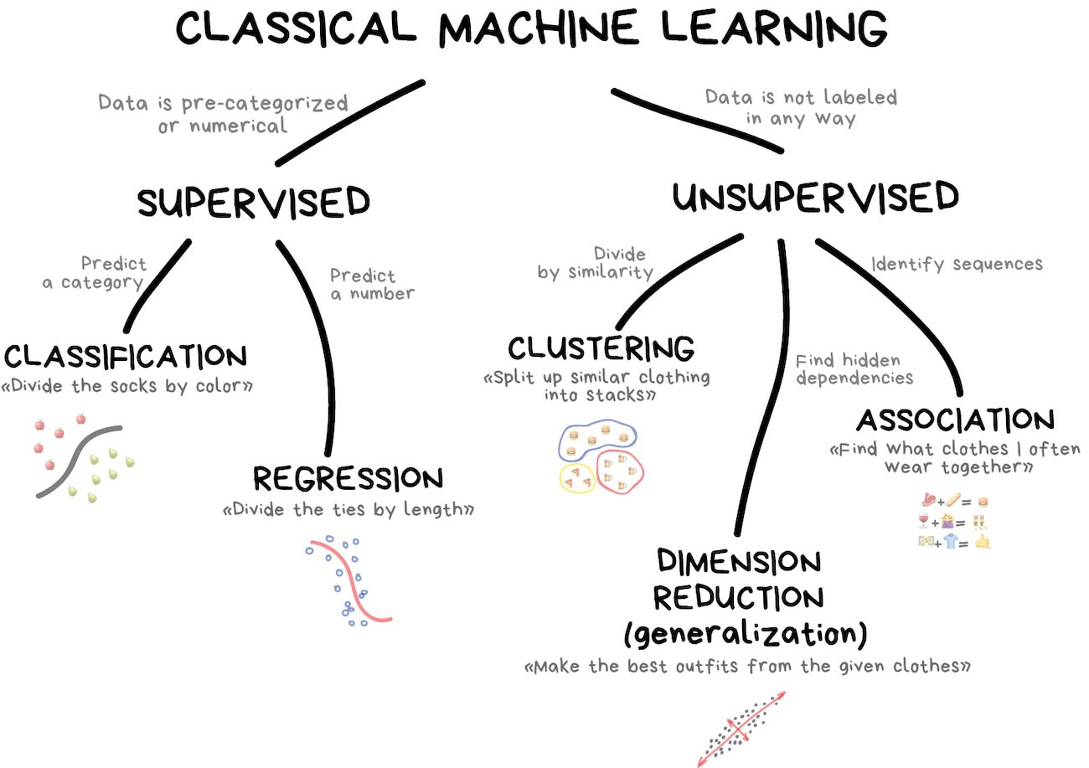
Taxonomy of “Classical” ML Models

Slide 3
Elements of Statistical Learning

Slide 4
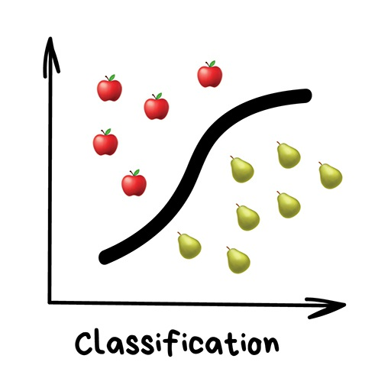
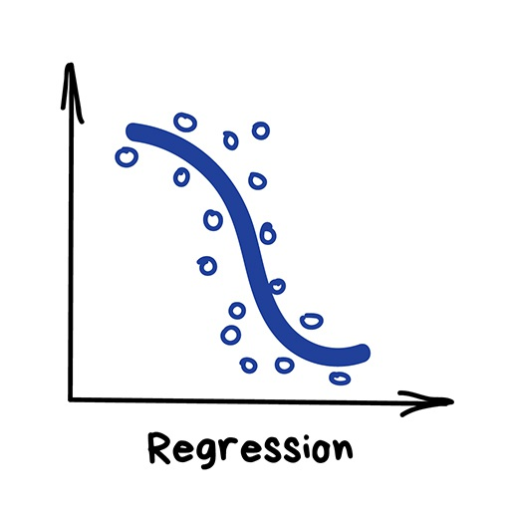
The Statistical Machine Learning Framework
Data
Domain set
Label set
A joint probability distribution on training data
Model
A prediction function
Measure of success
A loss function

Slide 5
Measurement of Success
Given the prediction function and the loss function, the loss of an example is
Training error/ empirical error of
Generalization error/ risk/ true error

Slide 6
Learning Objective
Given a collection of observations, and a model class, the goal of learning is to determine an estimator that best matches the observation (i.e., with the minimal error w.r.t. a certain loss function)

Slide 7
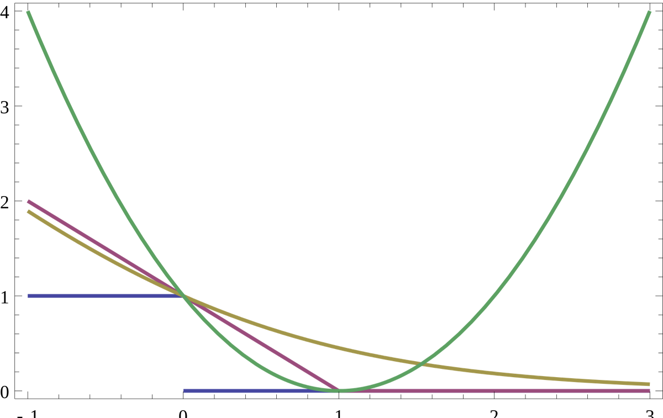
Example of Loss Functions (Classification)
0-1 loss:
misclassification error
hinge loss :
penalize correct predictions when not confident
log loss:
always wants more “margin”
square loss
magnify penalties if is large

Slide 8
Regularization

Slide 9
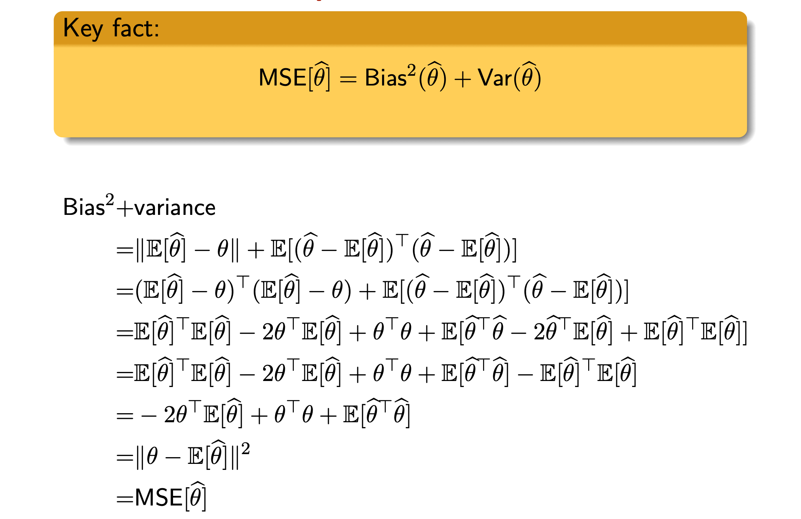
Bias-Variance Decomposition
Bias
Variance
MSE

Slide 10
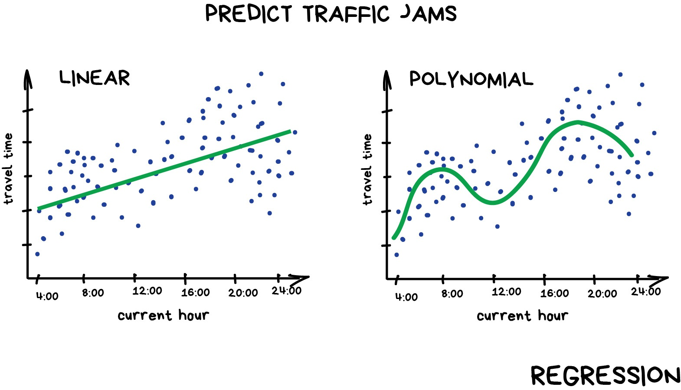
Bias Variance Tradeoff
bias
variance
MSE
k

Slide 11
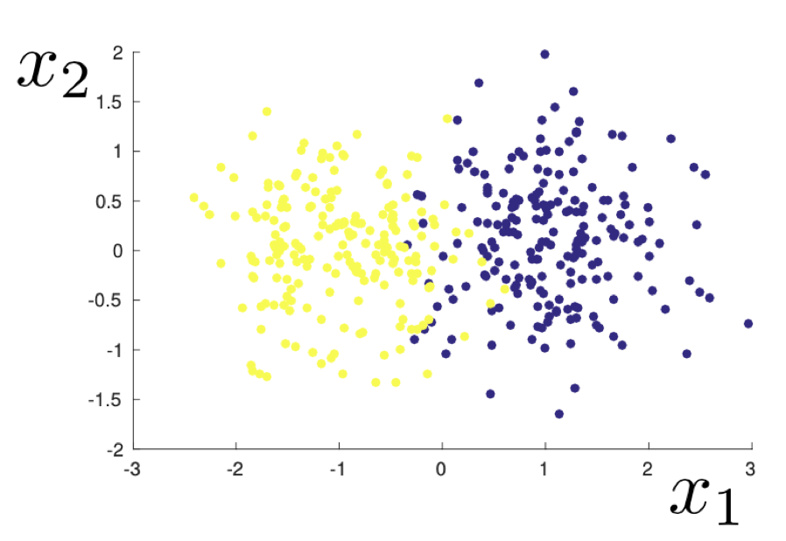
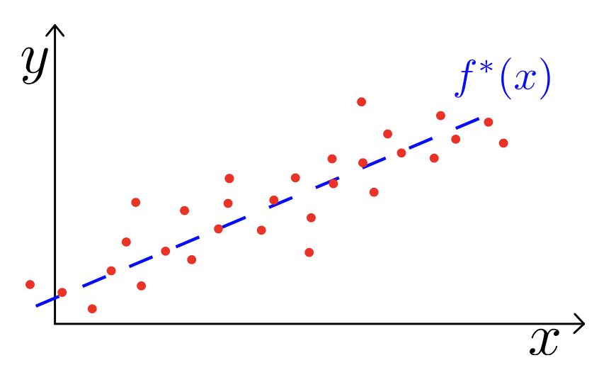
Stability, Overfitting, and Regularization
2D example of a dataset sampled from a mixed Gaussian distribution
Fixed unknown linear function

